Slide 1
tkinter

Slide 2
Use to create a desktop GUI
Python offers multiple options for developing GUI (Graphical User Interface). Out of all the GUI methods, tkinter is the most commonly used method.
It is a standard Python interface to the Tk GUI toolkit shipped with Python.
Python with tkinter is the fastest and easiest way to create the GUI applications. Creating a GUI using tkinter is an easy task.

Slide 3
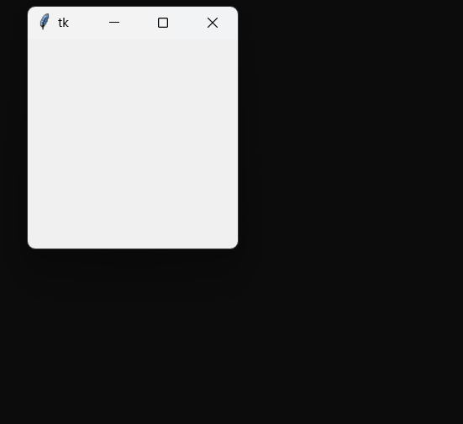
Step
Import the module Tkinter
Build a GUI application (as a window)
Add those widgets
Enter the main event's loop for taking action when the user triggered the event.
from tkinter import *
#creating the application main window.
root = Tk()
#Entering the event main loop
root.mainloop()

Slide 4
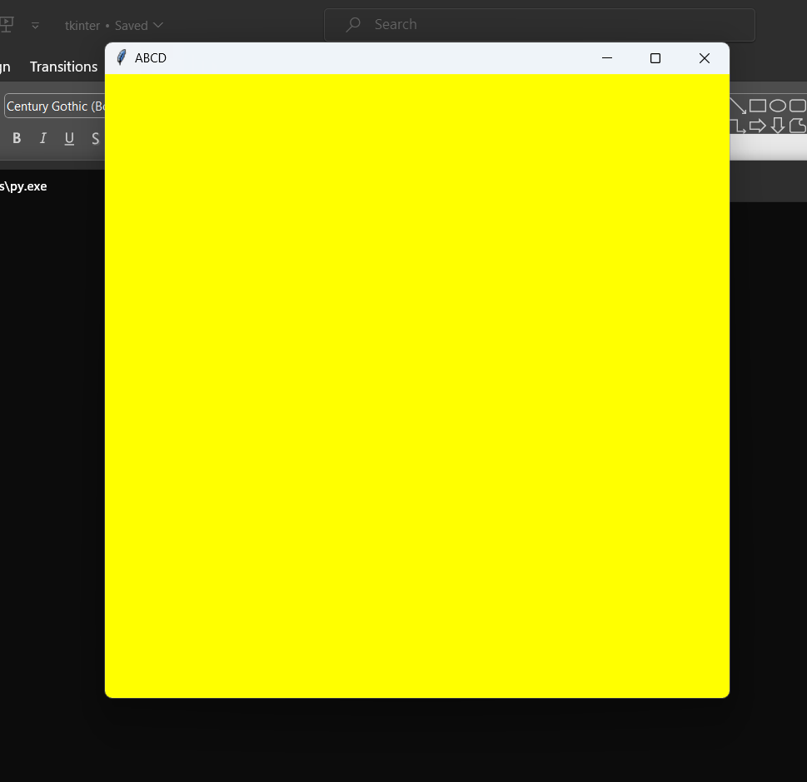
from tkinter import *
root=Tk()
root.geometry('600x600+350+40')
root.title('ABCD')
root.configure(bg="Yellow")
root.mainloop()

Slide 5
Widgets
tkinter provides us with a variety of common GUI elements which we can use to build out interface – such as buttons, menus and various kind of entry fields and display areas. We call these elements Widgets.
In general, Widget is an element of Graphical User Interface (GUI) that displays/illustrates information or gives a way for the user to interact
Each separate widget is a Python object. When creating a widget, you must pass its parent as a parameter to the widget creation function.

Slide 6
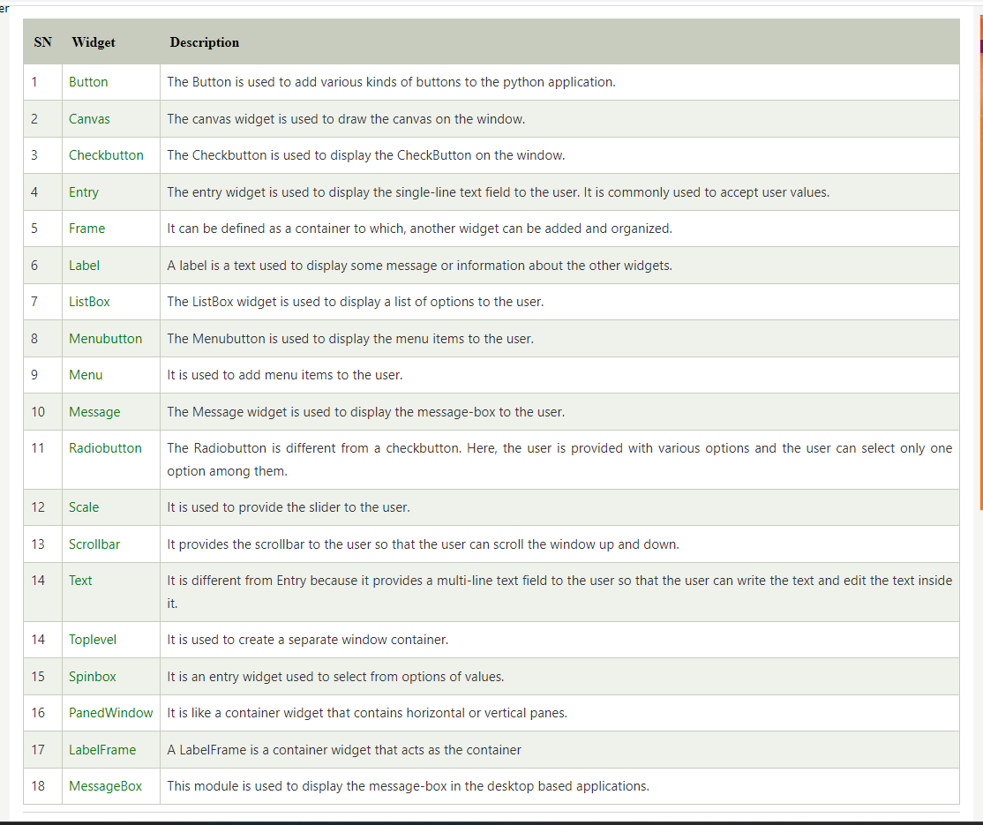

Slide 7
from tkinter import *
# create root window
root = Tk()
# button inside
b1= Button(root,text=“click”)
b1.pack()
#entry
e1=Entry(root,width=20)
e1.pack()
# Tkinter event loop
root.mainloop()

Slide 8
Python Tkinter Geometry
The Tkinter geometry specifies the method by using which, the widgets are represented on display. The python Tkinter provides the following geometry methods.
The pack() method
The grid() method
The place() method

Slide 9
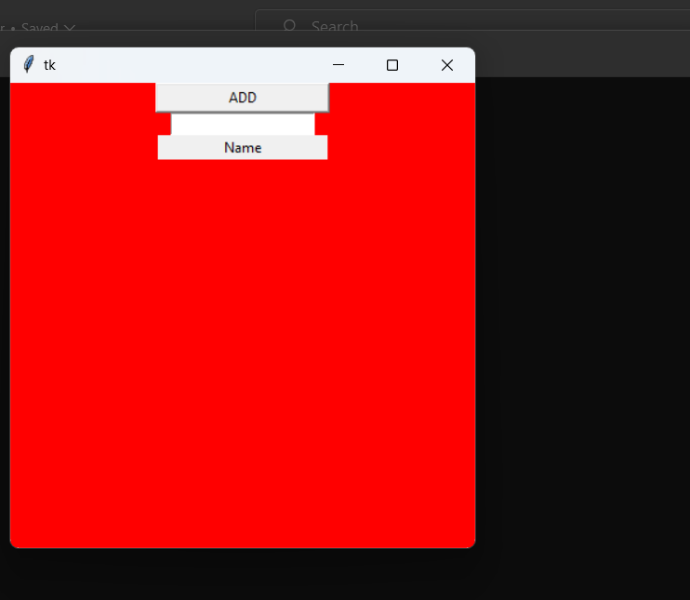
Python Tkinter pack() method
The pack() widget is used to organize widget in the block.
from tkinter import *
root=Tk()
root.geometry("400x400+350+40")
root.configure(bg="red")
b1=Button(root,width=20,text="ADD")
l1=Label(root,width=20,text="Name")
e1=Entry(root,width=20)
b1.pack()
e1.pack()
l1.pack()
root.mainloop()

Slide 10
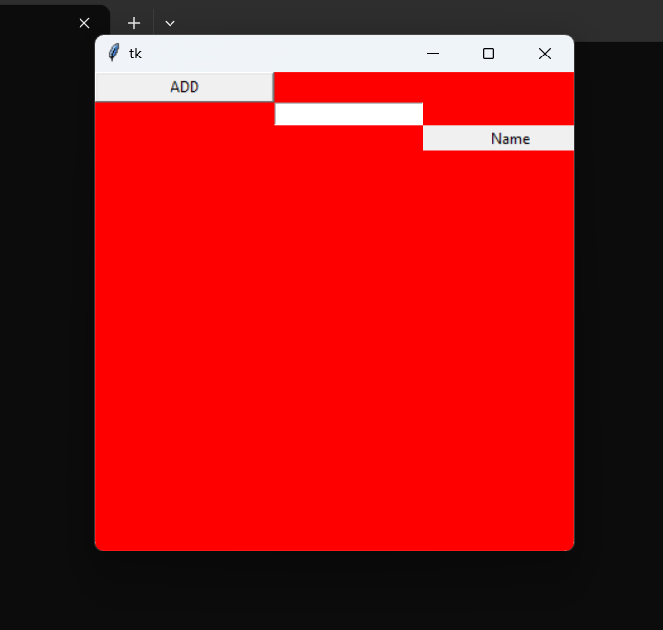
Python Tkinter grid() method
The grid() geometry manager organizes the widgets in the tabular form. We can specify the rows and columns as the options in the method call.
from tkinter import *
root=Tk()
root.geometry("400x400+350+40")
root.configure(bg="red")
b1=Button(root,width=20,text="ADD")
l1=Label(root,width=20,text="Name")
e1=Entry(root,width=20)
b1.grid(row=0,column=1)
e1.grid(row=1,column=2)
l1.grid(row=2,column=3)
root.mainloop()

Slide 11
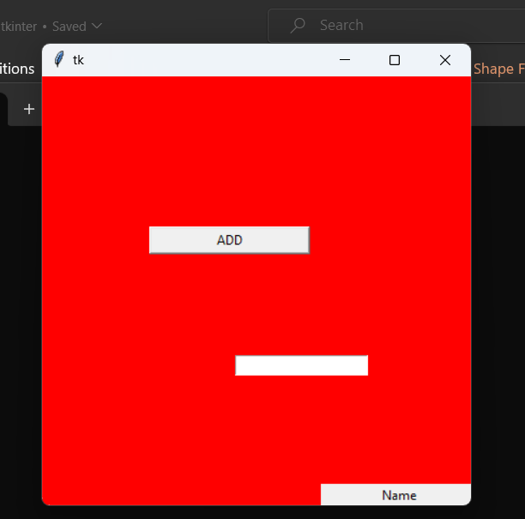
Python Tkinter place() method
The place() geometry manager organizes the widgets to the specific x and y coordinates.
from tkinter import *
root=Tk()
root.geometry("400x400+350+40")
root.configure(bg="red")
b1=Button(root,width=20,text="ADD“,)
l1=Label(root,width=20,text="Name")
e1=Entry(root,width=20)
b1.place(relx=0.25,rely=0.35)
e1.place(relx=0.45,rely=0.65)
l1.place(relx=0.65,rely=0.95)
root.mainloop()

Slide 12
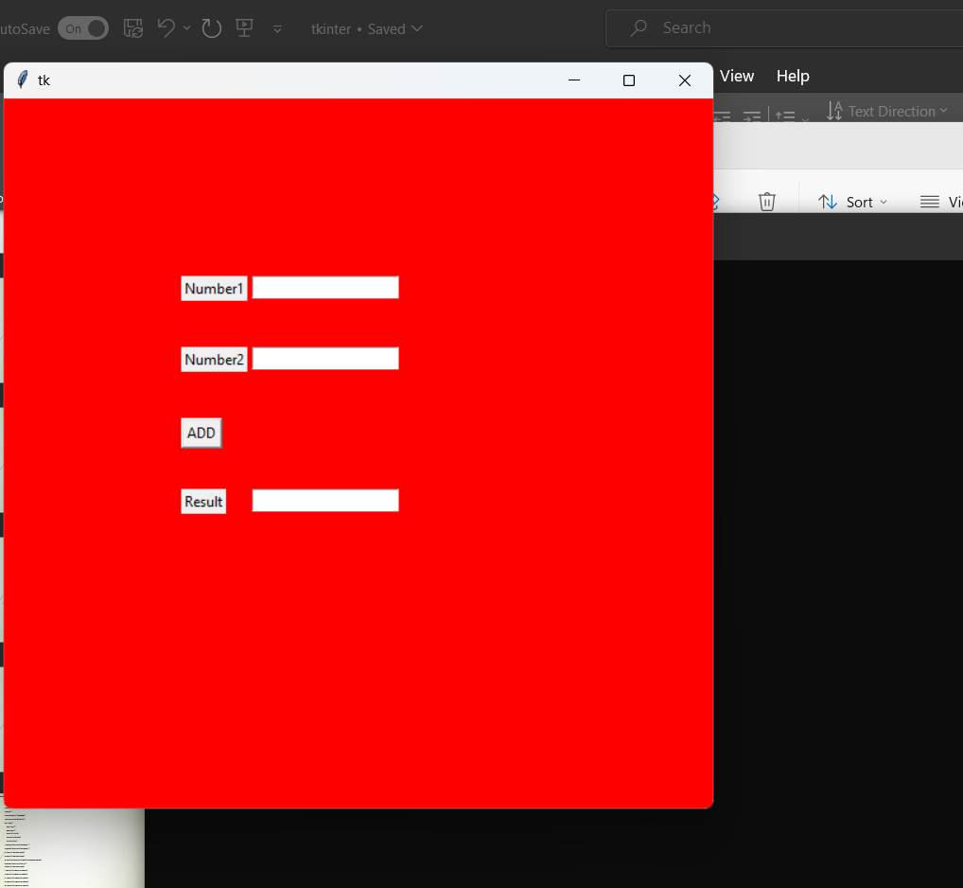
Simple calculater
from tkinter import *
root=Tk()
root.geometry('600x600')
root.configure(bg="red")
def add():
a=e1.get()
b=e2.get()
c=int(a)+int(b)
e3.delete(0,END)
e3.insert(0,c)

Slide 13
l1=Label(root,text="Number1")
l2=Label(root,text="Number2")
e1=Entry(root,width=20)
e2=Entry(root,width=20)
b1=Button(root,text="ADD",command=add)
l3=Label(root,text="Result")
e3=Entry(root,width=20)
l1.place(relx=0.25,rely=0.25)
l2.place(relx=0.25,rely=0.35)
e1.place(relx=0.35,rely=0.25)
e2.place(relx=0.35,rely=0.35)
b1.place(relx=0.25,rely=0.45)
l3.place(relx=0.25,rely=0.55)
e3.place(relx=0.35,rely=0.55)
root.mainloop()

Slide 14
from tkinter import *
root=Tk()
root.geometry("600x600+350+40")
import pymysql
con=pymysql.connect(host='localhost',port=3306,user='root',passwd='root',db='sampltk')
cmd=con.cursor()
def reg():
name=e1.get()
age=e2.get()
addr=e3.get()
ph=e4.get()
cmd.execute("insert into reg(name,age,addr,ph) values('"+name+"',"+age+",'"+addr+"','"+ph+"')")
con.commit()

Slide 15
l1=Label(root,text="Name")
l2=Label(root,text="Age")
l3=Label(root,text="Address")
l4=Label(root,text="Ph")
e1=Entry(root)
e2=Entry(root)
e3=Entry(root)
e4=Entry(root)
b1=Button(root,text="submit",command=reg)
l1.place(relx=0.25,rely=0.25)
l2.place(relx=0.25,rely=0.35)
l3.place(relx=0.25,rely=0.45)
l4.place(relx=0.25,rely=0.55)
e1.place(relx=0.55,rely=0.25)
e2.place(relx=0.55,rely=0.35)
e3.place(relx=0.55,rely=0.45)
e4.place(relx=0.55,rely=0.55)
b1.place(relx=0.25,rely=0.65)
root.mainloop()

Slide 16
